Slide 1

Final Project
Time Varying Linear Regression on
Price of Apartment in Korea
Jaehyun lee

Slide 2
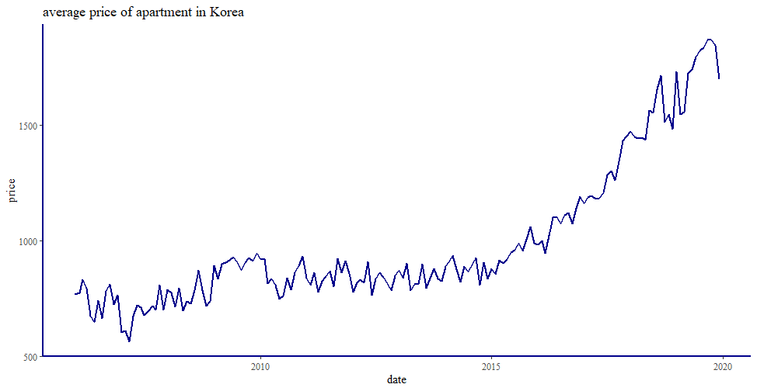
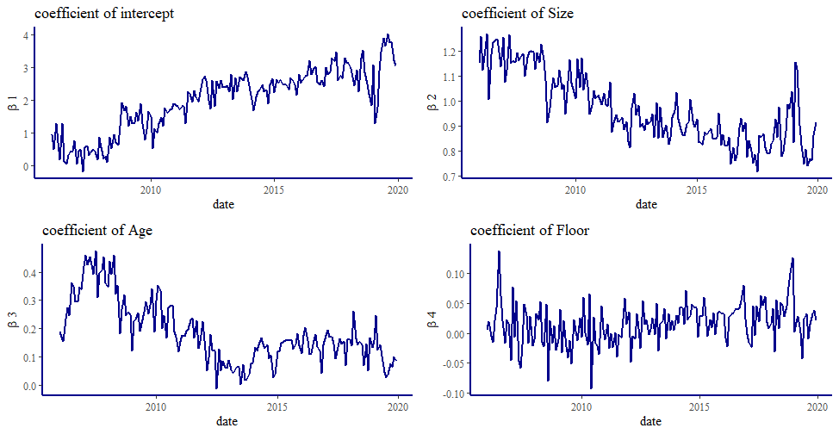
1. Motivation
Paint a picture for you and me on the days when we were young
Forecasting price of apartment
Changing Relationship
Personal interest
Increasing trend in average housing price
Goal: Predicting accurate housing price of future time point.
People’s preference
Economic or social circumstance

Slide 3
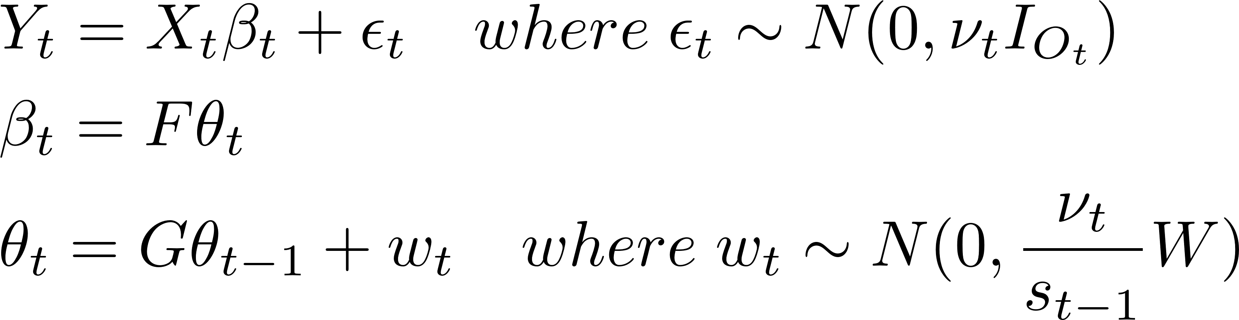
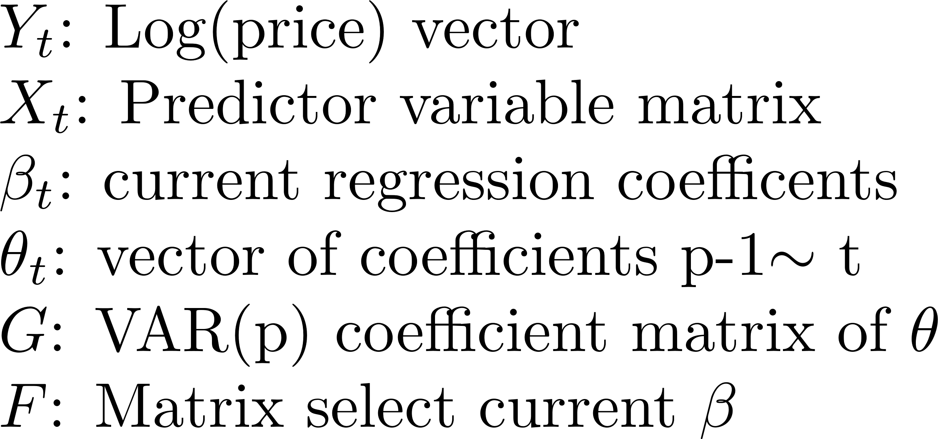
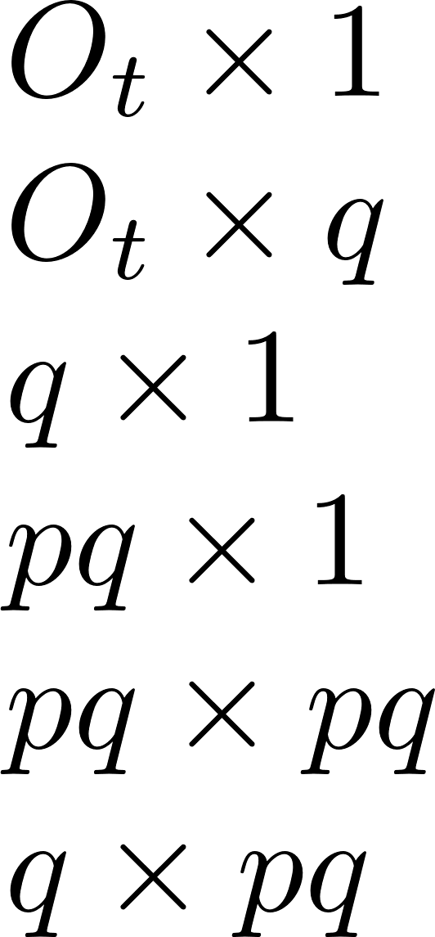

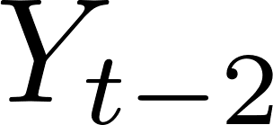
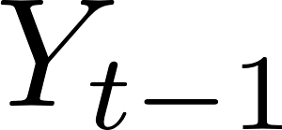





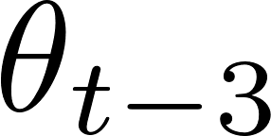
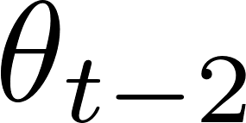
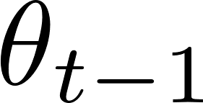

2. Model
Paint a picture for you and me on the days when we were young
Model structure
Description
Dimension
Graphical model

Slide 4
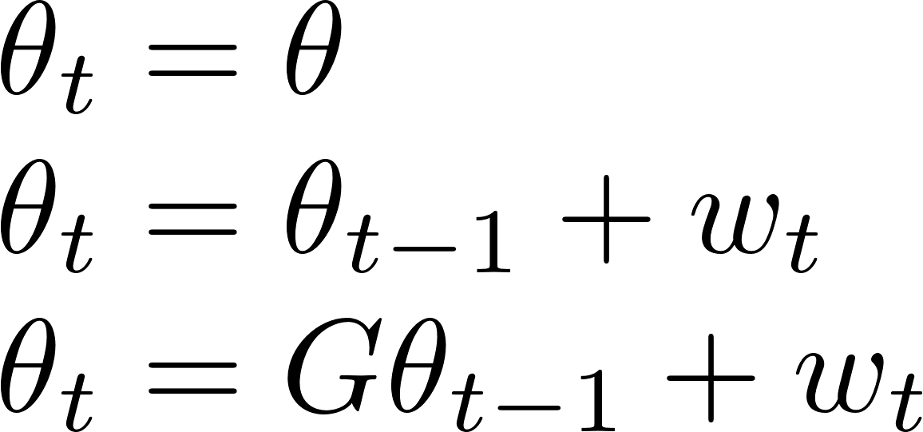
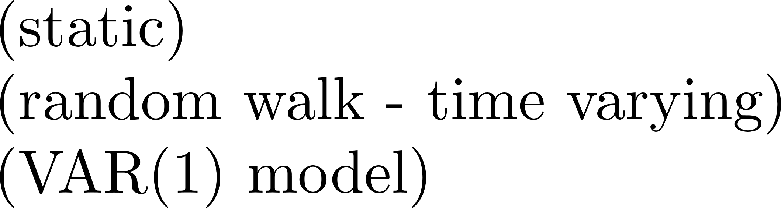

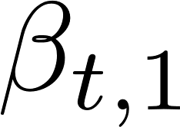
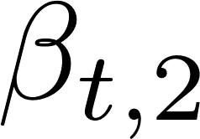
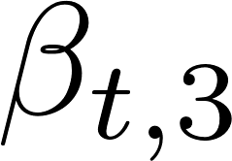
3. Assessment
Paint a picture for you and me on the days when we were young
Model comparison
Criterion
Future topic
Model quality
Dynamic Latent factor model
Prediction performance
Hierarchical Dynamic linear model

Slide 5

Q&A

